Slide 1
Bag of Words
Bag of words is a Natural Language Processing technique of text modelling. In technical terms, we can say that it is a method of feature extraction with text data. This approach is a simple and flexible way of extracting features from documents.
A bag of words is a representation of text that describes the occurrence of words within a document.
We just keep track of word counts and disregard the grammatical details and the word order. It is called a “bag” of words because any information about the order or structure of words in the document is discarded.
The model is only concerned with whether known words occur in the document, not where in the document.

Slide 2
Why is the Bag-of-Words algorithm used?
So, why bag-of-words, what is wrong with the simple and easy text?
One of the biggest problems with text is that it is messy and unstructured, and machine learning algorithms prefer structured, well defined fixed-length inputs and by using the Bag-of-Words technique we can convert variable-length texts into a fixed-length vector.
Also, at a much granular level, the machine learning models work with numerical data rather than textual data.
So to be more specific, by using the bag-of-words (BoW) technique, we convert a text into its equivalent vector of numbers.

Slide 3
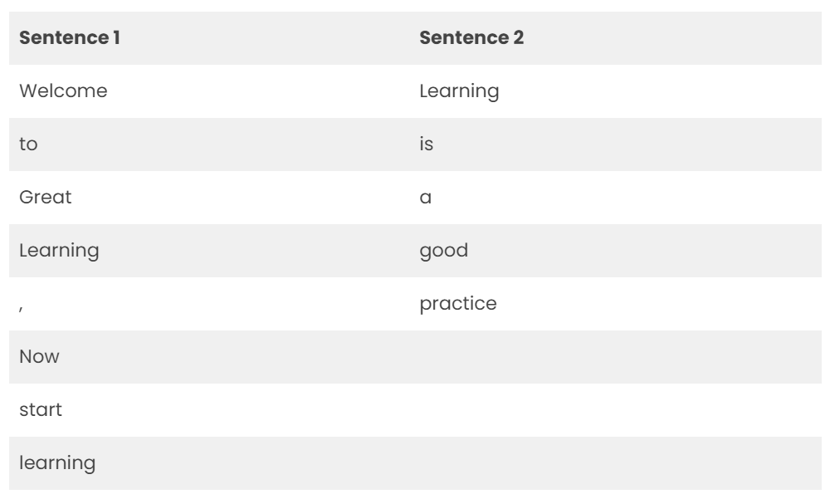
Understanding Bag of Words with an example
Example(1) without preprocessing:
Sentence 1: ”Welcome to Great Learning, Now start learning”
Sentence 2: “Learning is a good practice”

Slide 4
Understanding Bag of Words with an example
Step 1: Go through all the words in the above text and make a list of all of the words in our model vocabulary.
Welcome
To
Great
Learning
,
Now
start
learning
is
a
good
practice

Slide 5
Understanding Bag of Words with an example
Note that the words ‘Learning’ and ‘ learning’ are not the same here because of the difference in their cases and hence are repeated. Also, note that a comma ‘ , ’ is also taken in the list.
Because we know the vocabulary has 12 words, we can use a fixed-length document-representation of 12, with one position in the vector to score each word.
The scoring method we use here is to count the presence of each word and mark 0 for absence. This scoring method is used more generally.
The scoring of sentence 1 would look as follows:

Slide 6
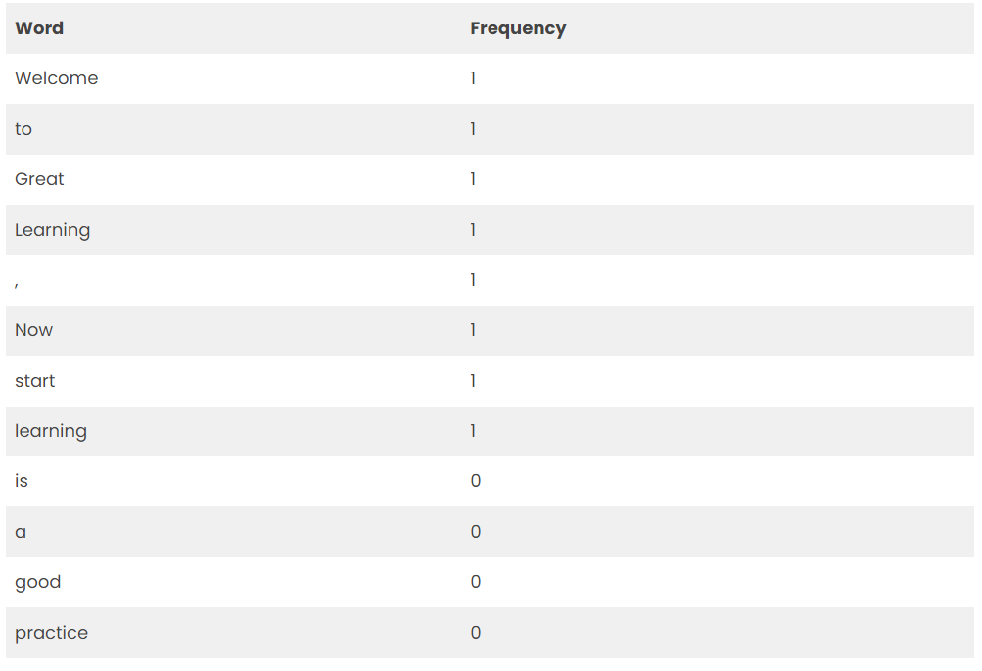
Understanding Bag of Words with an example

Slide 7
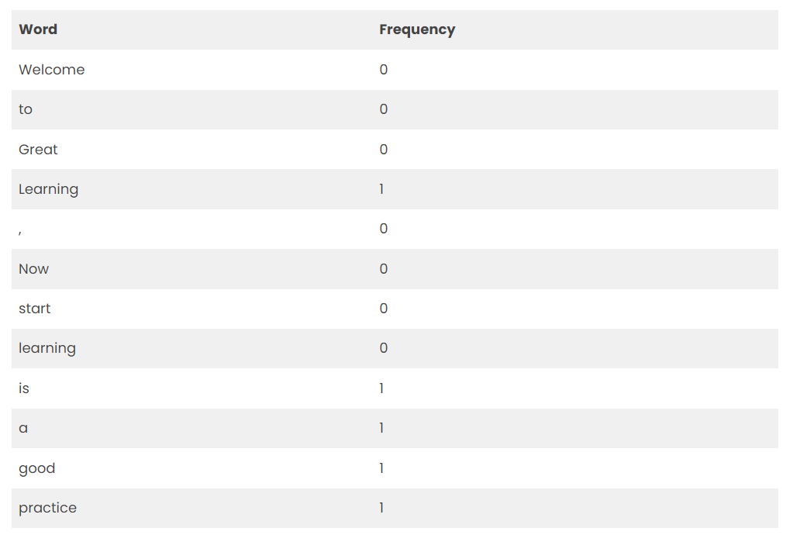
Understanding Bag of Words with an example
Writing the above frequencies in the vector
Sentence 1 ➝ [ 1,1,1,1,1,1,1,1,0,0,0 ]
Now for sentence 2, the scoring would like

Slide 8
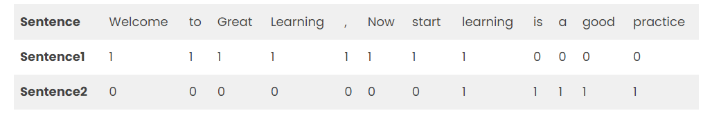
Understanding Bag of Words with an example
Similarly, writing the above frequencies in the vector form
Sentence 2 ➝ [ 0,0,0,0,0,0,0,1,1,1,1,1 ]
But is this the best way to perform a bag of words. The above example was not the best example of how to use a bag of words. The words Learning and learning, although having the same meaning are taken twice. Also, a comma ’,’ which does not convey any information is also included in the vocabulary.
Let us make some changes and see how we can use ‘bag of words in a more effective way.

Slide 9
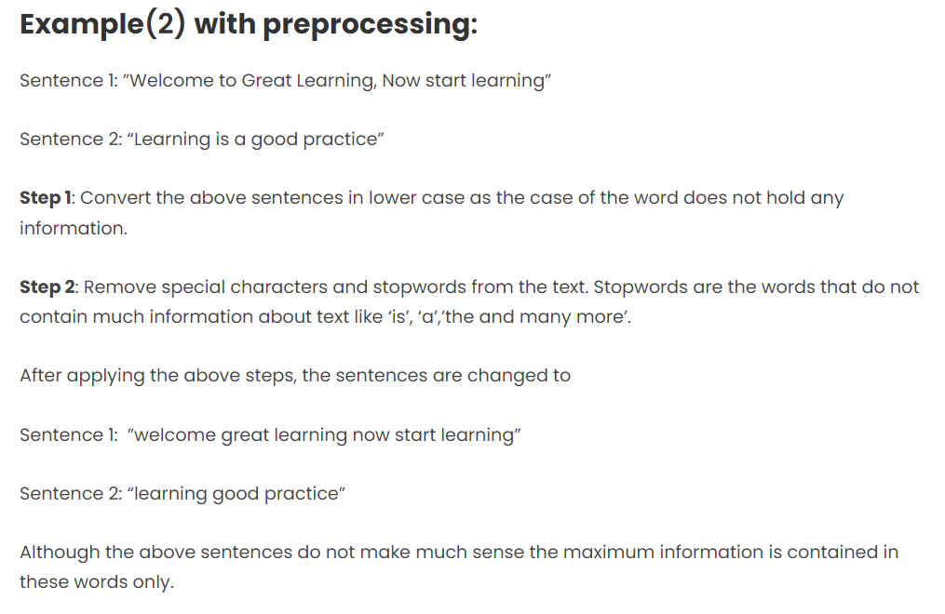

Slide 10
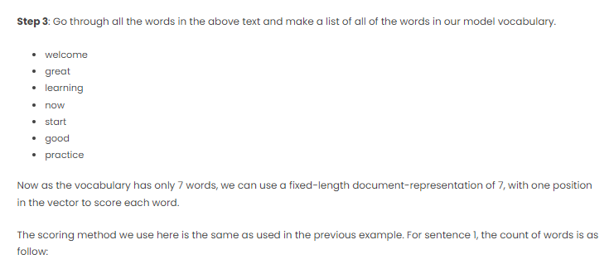

Slide 11
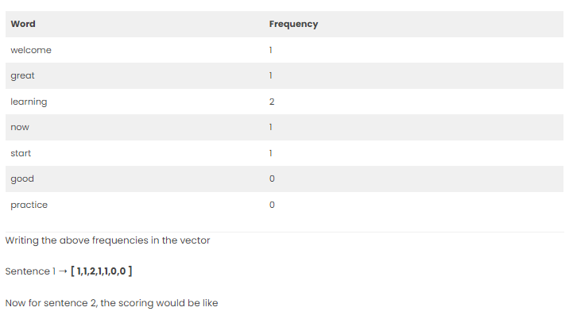

Slide 12
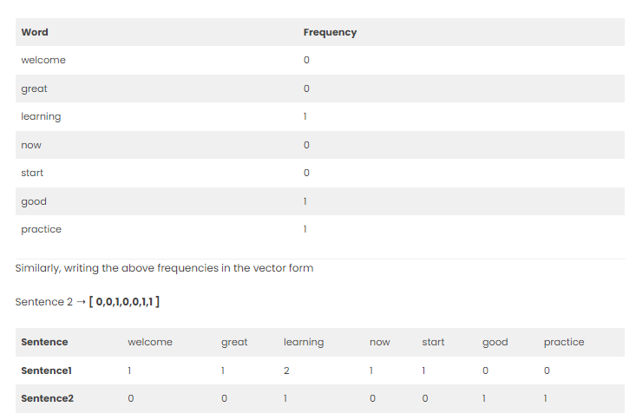

Slide 13
The approach used in example two is the one that is generally used in the Bag-of-Words technique, the reason being that the datasets used in Machine learning are tremendously large and can contain vocabulary of a few thousand or even millions of words. Hence, preprocessing the text before using bag-of-words is a better way to go.
There are various preprocessing steps that can increase the performance of Bag-of-Words.
In the examples above we use all the words from vocabulary to form a vector, which is neither a practical way nor the best way to implement the BoW model. In practice, only a few words from the vocabulary, more preferably most common words are used to form the vector.

Slide 14
What are N-Grams?
Again same questions, what are n-grams and why do we use them? Let us understand this with an example below-
Sentence 1: “This is a good job. I will not miss it for anything”
Sentence 2: ”This is not good at all”
For this example, let us take the vocabulary of 5 words only. The five words being-
good
job
miss
not
all
So, the respective vectors for these sentences are:
“This is a good job. I will not miss it for anything”=[1,1,1,1,0]
”This is not good at all”=[1,0,0,1,1]

Slide 15
What are N-Grams?
Can you guess what is the problem here? Sentence 2 is a negative sentence and sentence 1 is a positive sentence. Does this reflect in any way in the vectors above? Not at all. So how can we solve this problem? Here come the N-grams to our rescue.
An N-gram is an N-token sequence of words: a 2-gram (more commonly called a bigram) is a two-word sequence of words like “really good”, “not good”, or “your homework”, and a 3-gram (more commonly called a trigram) is a three-word sequence of words like “not at all”, or “turn off light”.
For example, the bigrams in the first line of text in the previous section: “This is not good at all” are as follows:
“This is”
“is not”
“not good”
“good at”
“at all”
Now if instead of using just words in the above example, we use bigrams (Bag-of-bigrams) as shown above. The model can differentiate between sentence 1 and sentence 2. So, using bi-grams makes tokens more understandable (for example, “HSR Layout”, in Bengaluru, is more informative than “HSR” and “layout”)
So we can conclude that a bag-of-bigrams representation is much more powerful than bag-of-words, and in many cases proves very hard to beat.

Slide 16
What is Tf-Idf ( term frequency-inverse document frequency)?
The scoring method being used above takes the count of each word and represents the word in the vector by the number of counts of that particular word. What does a word having high word count signify?
Does this mean that the word is important in retrieving information about documents? The answer is NO. If a word occurs many times in a document but also along with many other documents in our dataset, maybe it is because this word is just a frequent word; not because it is relevant or meaningful.
One approach is to rescale the frequency of words by how often they appear in all documents so that the scores for frequent words like “the” that are also frequent across all documents are penalized. This approach is called term frequency-inverse document frequency or shortly known as Tf-Idf approach of scoring.
TF-IDF is intended to reflect how relevant a term is in a given document. So how is Tf-Idf of a document in a dataset calculated?
TF-IDF for a word in a document is calculated by multiplying two different metrics:

Slide 17
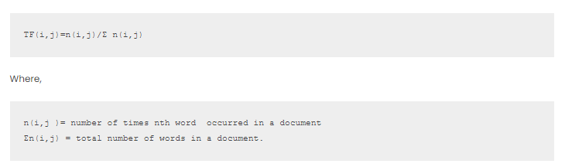
What is Tf-Idf ( term frequency-inverse document frequency)?
The term frequency (TF) of a word in a document. There are several ways of calculating this frequency, with the simplest being a raw count of instances a word appears in a document. Then, there are other ways to adjust the frequency. For example, by dividing the raw count of instances of a word by either length of the document, or by the raw frequency of the most frequent word in the document. The formula to calculate Term-Frequency is

Slide 18
What is Tf-Idf ( term frequency-inverse document frequency)?
The inverse document frequency(IDF) of the word across a set of documents. This suggests how common or rare a word is in the entire document set. The closer it is to 0, the more common is the word. This metric can be calculated by taking the total number of documents, dividing it by the number of documents that contain a word, and calculating the logarithm.
So, if the word is very common and appears in many documents, this number will approach 0. Otherwise, it will approach 1.
Multiplying these two numbers results in the TF-IDF score of a word in a document. The higher the score, the more relevant that word is in that particular document.
To put it in mathematical terms, the TF-IDF score is calculated as follows:

Slide 19
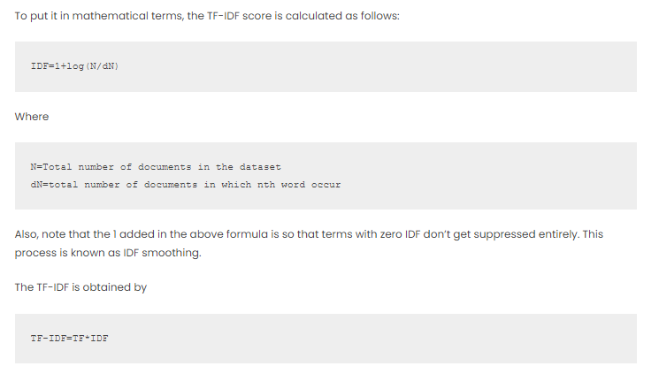
What is Tf-Idf ( term frequency-inverse document frequency)?

Slide 20
Limitations of Bag-of-Words
Although Bag-of-Words is quite efficient and easy to implement, still there are some disadvantages to this technique which are given below:
The model ignores the location information of the word. The location information is a piece of very important information in the text. For example “today is off” and “Is today off”, have the exact same vector representation in the BoW model.
Bag of word models doesn’t respect the semantics of the word. For example, words ‘soccer’ and ‘football’ are often used in the same context. However, the vectors corresponding to these words are quite different in the bag of words model. The problem becomes more serious while modeling sentences. Ex: “Buy used cars” and “Purchase old automobiles” are represented by totally different vectors in the Bag-of-words model.
The range of vocabulary is a big issue faced by the Bag-of-Words model. For example, if the model comes across a new word it has not seen yet, rather we say a rare, but informative word like Biblioklept(means one who steals books). The BoW model will probably end up ignoring this word as this word has not been seen by the model yet.

